Slide 1
Principal Component Analysis
Chapter 6: Feature extraction_PCA

Slide 2
Outline
Motivation
Overview
Intuitive approach
Computation of PCA
A Gaussian viewpoint
Kernel PCA
Exercise

Slide 3
Motivation
Question: What if the dimension of features we used is too high due to
  Correlation between features
  Not enough training samples(curse of dimensionality)
Solution: reduce the dimension of features by
  Choosing some features that are most useful out
  Deriving new low-dimension-features from the old one. (PCA can do this well)

Slide 4
Overview
Principal component analysis (PCA) is a way to reduce data dimensionality
PCA projects high dimensional data to a lower dimension
PCA projects the data in the least square error sense– it captures big (principal) variability in the data and ignores small variability

Slide 5
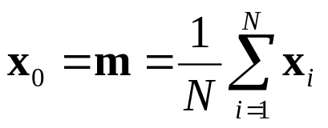
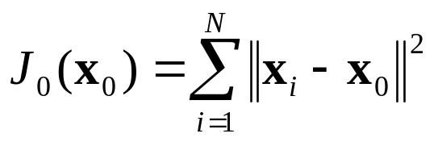
Intuitive approach
Let us say we have x_{i}, i=1…N data points in p dimensions (p is large)
If we want to represent the data set by a single point x₀, then
Can we justify this choice mathematically?
It turns out that if you minimize J₀, you get the above solution

Slide 6

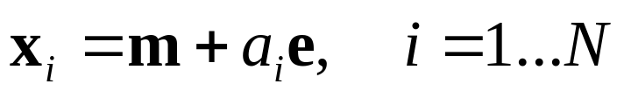
Intuitive approach
Representing the data set x_{i}, i=1…N by its mean is quite uninformative. So let’s try to represent the data set by a straight line of the form:
This is equation of a straight line that says that it passes through m, e is a unit vector along the straight line. And the signed distance of a point x from m is a
The training points projected on this straight line would be

Slide 7
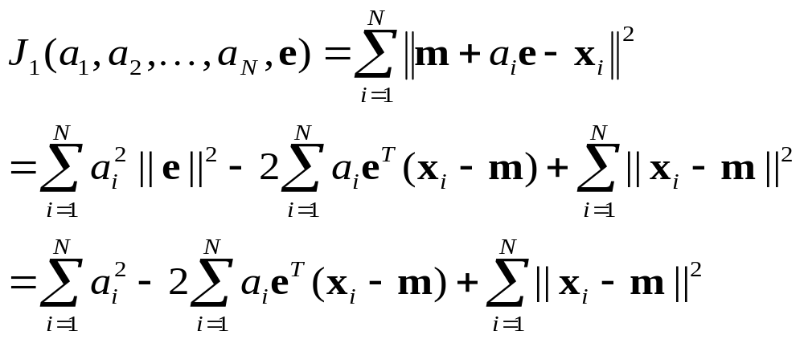

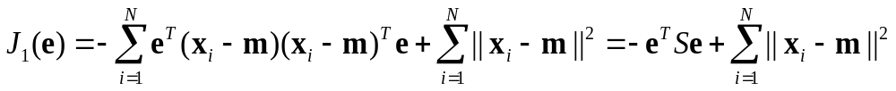
Intuitive approach
Let’s now determine a_{i}’s
Partially differentiating with respect to a_{i} we get:
Plugging in this expression for a_{i} in J₁ we get:
S is called scatter matrix
Notes:
最后一个式子的由来，需要推导下。

Slide 8




Intuitive approach
So “minimizing J₁ ”↔ “maximizing ”
Subject to the constraint that e is a unit vector:
Use Lagrange multiplier method to form the objective function:
Differentiate to obtain the equation:
Solution is that e is the eigenvector of S corresponding to the largest eigenvalue
Notes:
Why only corresponding to the “largest eigenvalue”?

Slide 9
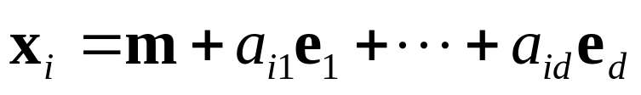
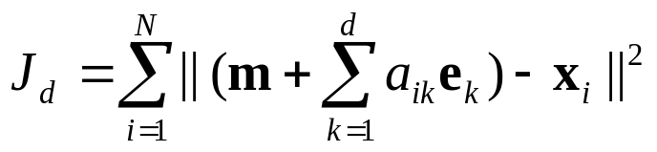
Intuitive approach
The preceding analysis can be extended in the following way:
  Instead of projecting the data points on to a straight line, we may now want to project them on a d-dimensional plane of the form:
  d is much smaller than the original dimension p
In this case one can form the objective function:
It can also be shown that the vectors e₁, e₂, …, e_{d} are d eigenvectors corresponding to d largest eigen values of the scatter matrix S

Slide 10
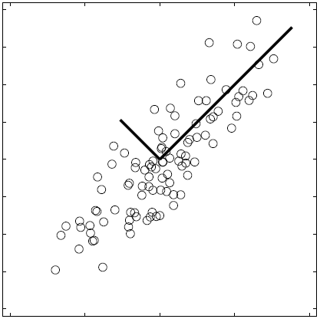
PCA Visualization
Data points are represented in a rotated orthogonal coordinate system: the origin is the mean of the data points and the axes are provided by the eigenvectors.

Slide 11

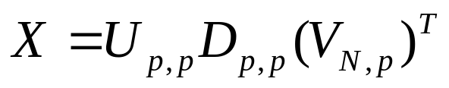
Computation
In practice we compute PCA via SVD (singular value decomposition)
Form the centered data matrix (when p<N):
Compute its SVD:
U and V are orthogonal matrices, D is a diagonal matrix

Slide 12

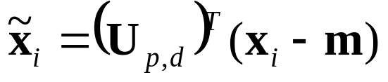
Computation
Note that the S matrix can be written as:
So the eigenvectors of S are the columns of U and the eigenvalues are the diagonal elements of D²
Take only a few significant eigenvalue-eigenvector pairs d << p; The new reduced dimension representation becomes:

Slide 13

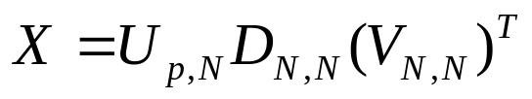
Computation
Sometimes we are given only a few high dimensional data points, i.e., p >> N
In such cases compute the SVD of X^{T}:
So that we get:
Then, proceed as before, choose only d < N significant eigenvalues for data representation:

Slide 14
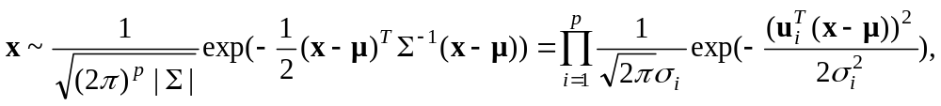
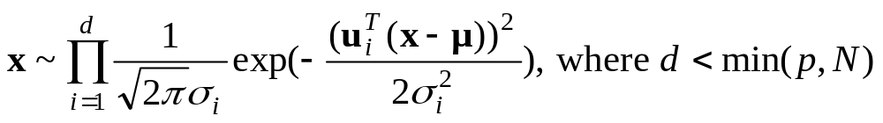
A Gaussian viewpoint
where the covariance matrix Σ is estimated from the scatter matrix as (1/N)S; u’s and σ’s are respectively eigenvectors and eigenvalues of S.
If p is large, then we need a even larger number of data points to estimate the covariance matrix. So, when a limited number of training data points is available the estimation of the covariance matrix goes quite wrong. This is known as curse of dimensionality in this context.
To combat curse of dimensionality, we discard smaller eigenvalues and be content with:

Slide 15
Kernel PCA
Assumption behind PCA is that the data points x are multivariate Gaussian
Often this assumption does not hold
However, it may still be possible that a transformation φ(x) is still Gaussian, then we can perform PCA in the space of φ(x)
Kernel PCA performs this PCA; however, because of “kernel trick,” it never computes the mapping φ(x) explicitly!

Slide 16
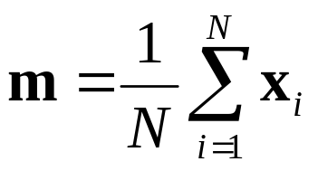
Exercise: Digital number classification
Preprocessing: “Normalize” numbers
  Make images the same size
  Normalize intensities (how?)
Raw features are pixel intensity values (400=20*20 features)
Each image is encoded as a vector X_{i} of these features
Compute “mean” number in training set:

Slide 17
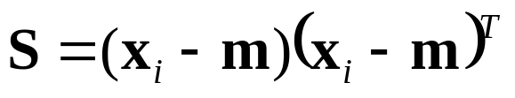
Exercise: Digital number classification
5. Compute the Scatter matrix
Compute the (unit) eigenvectors v_{i} of S
Keep only the first d principal components (eigenvectors) to compose U_{p,d}
The new reduced dimension representation becomes

Slide 18
Exercise: Digital number classification
The eigen-numbers encode the principal sources of variation in the dataset ( try to find some real meanings by show these eigen-numbers as images like eigenfaces!).
We can represent any number as a linear combination of these “basis” numbers. (show me!)
Use this new representation for:
  Number recognition
  (e.g., MED classifier and MICD classifier of number)
  “numbers” versus “no numbers”
  need “no number” training samples.

